Slide 1
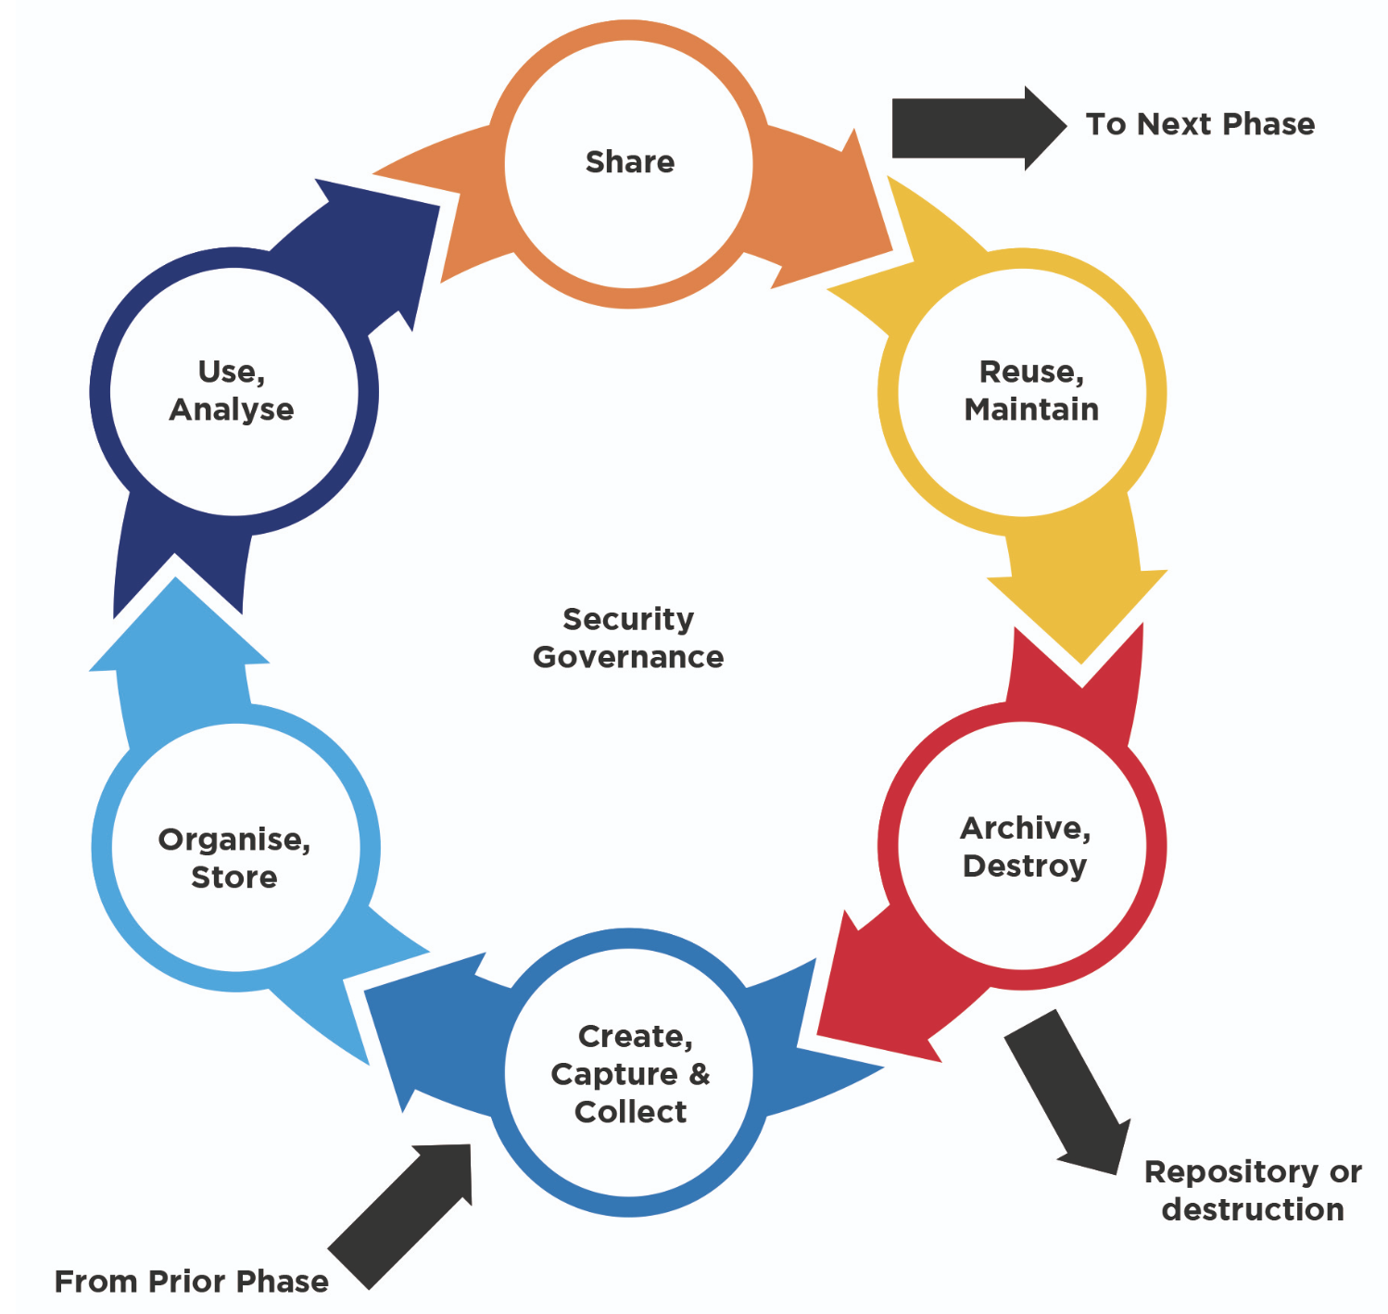
Project Report
Data Governance

Slide 2
Business Overview
Total Bill
Total Orders
Avg Delivery Charge
Avg Order Price
11.0 M
500
76.13
22053.44
Month of high orders
Preferred Order Type
Max Coupon Discount
% Customer Satisfaction
May
Prepaid
154
52.4%

Slide 3
Metrics

Slide 4
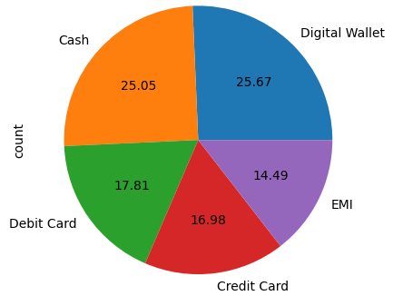
Preferred Order Payment for Customers
Observations / Findings
Preferred Order Payment: Digital Wallet
Percentage of Order Payment done through Digital Wallet: 24.67

Slide 5
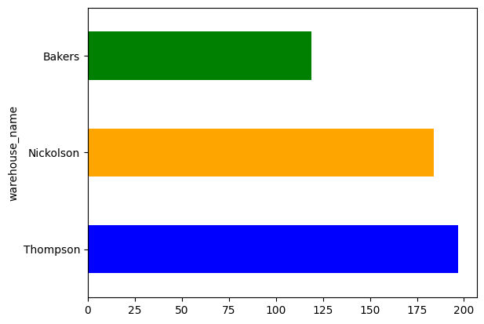
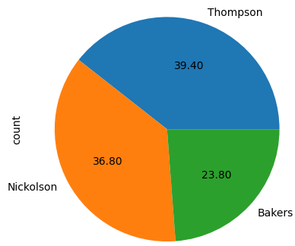
Major Deliveries Done from which Warehouse
Observations / Findings
Major Deliveries from Warehouse: Thompson
Percentage of Major Deliveries from Warehouse: 38.8560157790927

Slide 6
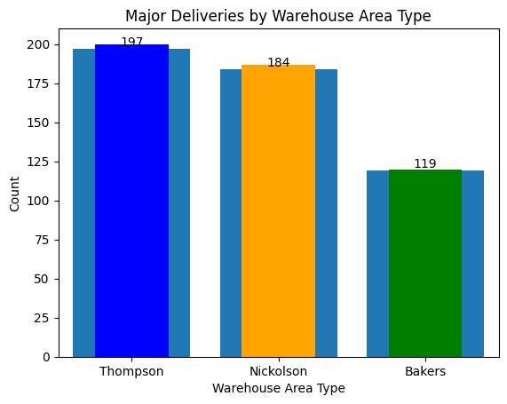
Major Deliveries Made from which Warehouse
Observations / Findings
Major Deliveries from Warehouse Area Type: Industrial
Percentage of Major Deliveries from Warehouse Area Type: 38.86

Slide 7
Distribution of Customer Satisfaction
Hint: You can use a bar chart. Customer satisfaction in the x-axis and count as the y-axis
Observations / Findings

Slide 8
Distribution of Customer Occupation
Hint: You can use a bar chart. Customer occupation in the x-axis and count as the y-axis
Observations / Findings

Slide 9
Distribution of Customer Education
Hint: You can use a bar chart. Customer education in the x-axis and count as the y-axis
Observations / Findings

Slide 10
Proportion of Customer Satisfaction for Married
People
Hint: You can use a stacked bar chart or use pandas crosstab function to group the column values and display the bar chart
Observations / Findings

Slide 11
Distribution of Customer Satisfaction Across Order Type
Hint: You can use a stacked bar chart or use pandas crosstab function to group the column values and display the bar chart
Observations / Findings

Slide 12
Distribution of Customer Satisfaction Across Order Payment
Hint: You can use a stacked bar chart or use pandas crosstab function to group the column values and display the bar chart
Observations / Findings

Slide 13
Distribution of Age Level Customer Satisfaction
Hint: You can use a stacked bar chart or use pandas crosstab function to group the column values and display the bar chart
Observations / Findings

Slide 14
Customer Satisfaction Distribution across Different Coupon Discounts
Hint: You can use a stacked bar chart or use pandas crosstab function to group the column values and display the bar chart
Observations / Findings

Slide 15
Insights and Recommendations

Slide 16
Insights

Slide 17
Recommendations

